Slide 1


Hi!
I’m Panos
I do Physics and Math
HELLO!
RESEARCH
MORE
@

Slide 2
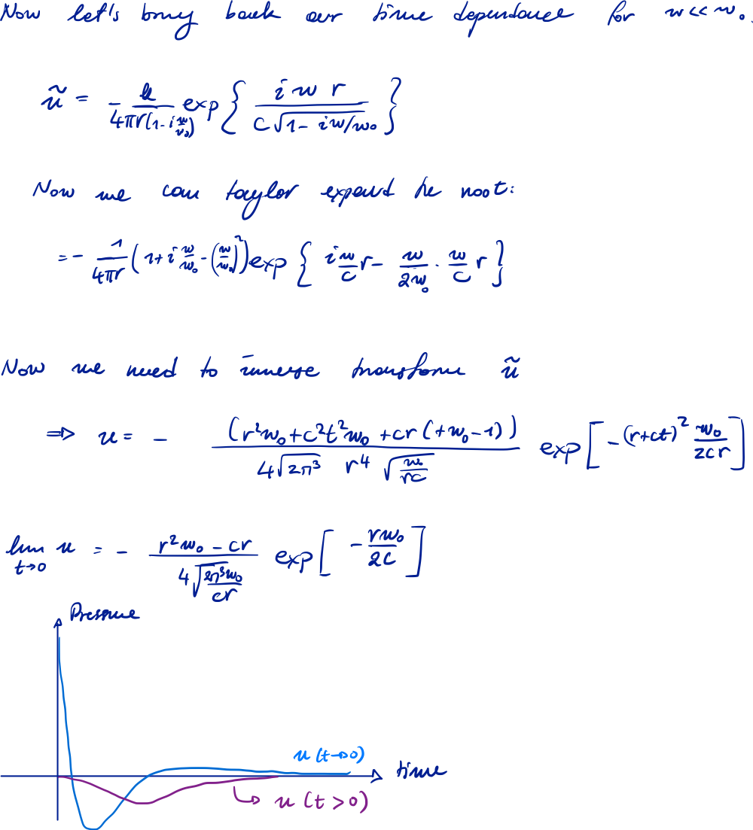
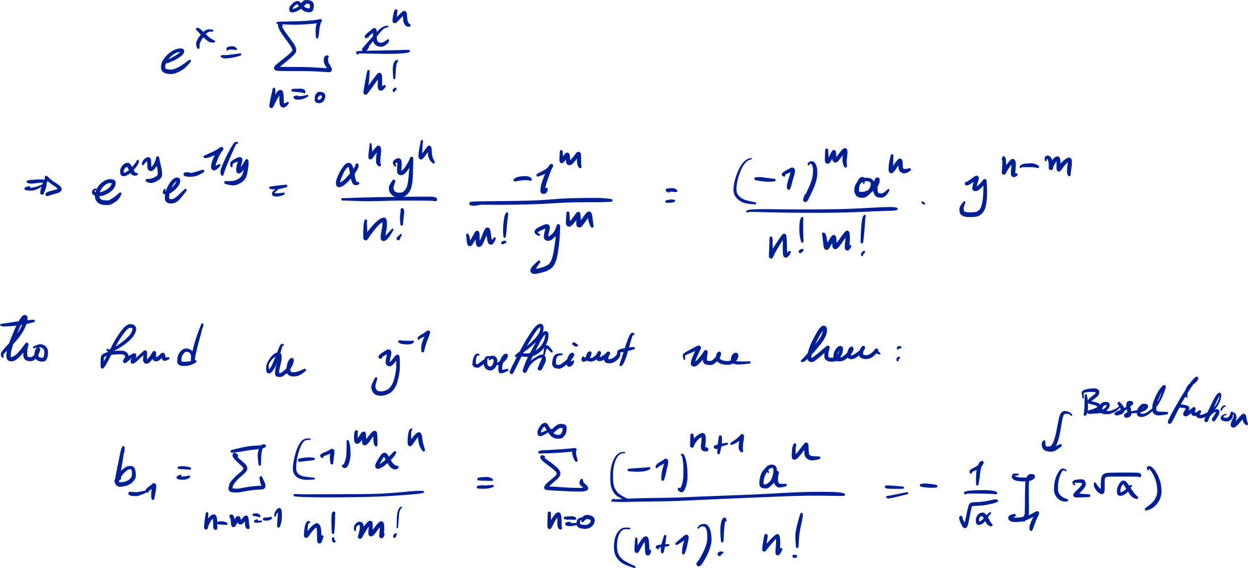
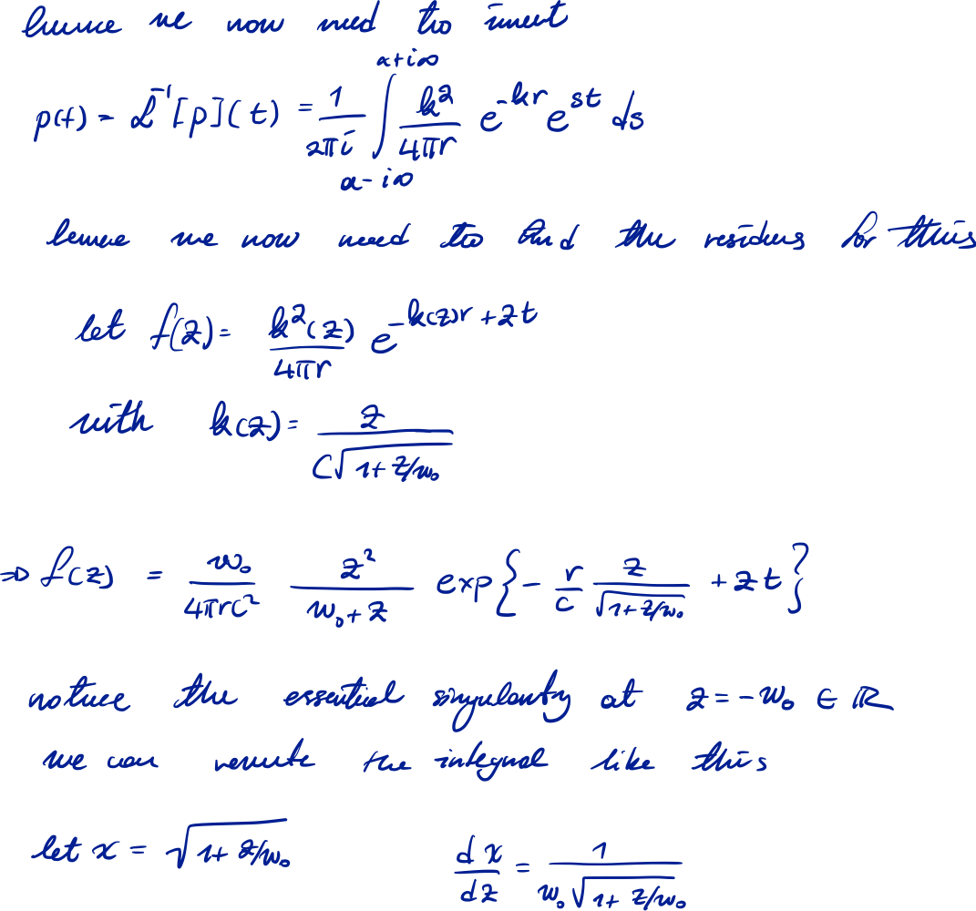
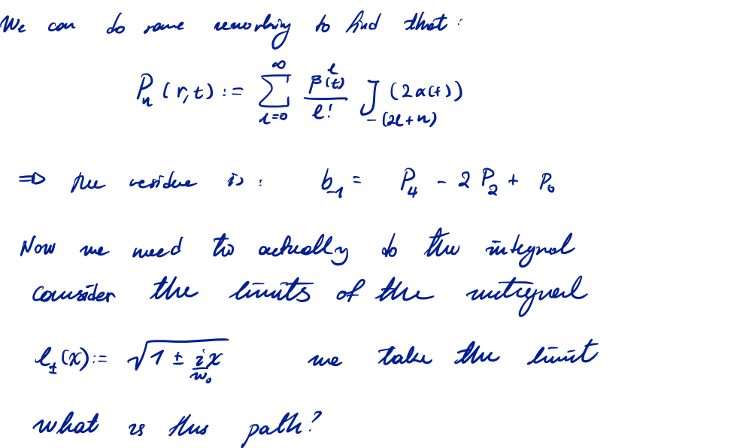
HELLO!
RESEARCH
MORE
@
CV
HELLO!
I’m a student at New York University studying Physics and Mathematics with a minor in Engineering.
I am currently doing research in Mathematical and High Energy Physics at NYUAD Astroparticle Laboratory and Sati Group.
My research interests include Astroparticle Physics, Partial Differential Equations, and Gauge Theories.
Resume, CV
Relevant Coursework

Slide 3
HELLO!
RESEARCH
MORE
@
CV
RESEARCH IN A NUTSHEL
I have had research experience in 3 different fields. Theoretical Physics, Experimental Physics, and Electrical Engineering.
In Theoretical Physics, I am currently working in understanding Gauge Theory in order to apply it to the study of Field Theories in Cosmology. I have also studied the theory of Neutrinoless Beta Decay and conducted my Undergraduate Thesis Project on theoretically predicting the acoustic signals of WIMPs in Noble Liquid detectors.
In Experimental Physics, I am currently part of the XENON Collaboration working on computational models for dark matter signal waveforms on the XENONnT detector, as well as worked on the design and development of a Dielectric Haloscope to detect Dark Photons.
In Engineering, I developed a theoretical continuous optimization algorithm based on stigmergy. I also worked on the design of haptic actuators, the theoretical, physical modelling of soft haptic materials and ground robotics.
Resume, CV
Relevant Coursework

Slide 4
HELLO!
RESEARCH
MORE
@
CV
RELEVANT SKILLS AND COURSEWORK
Here is a complete list of skills, courses, and projects for each of theoretical, experimental physics and engineering.
THEORETICAL PHYSICS
SKILLS
Here is a complete list of skills, courses, and projects for each of theoretical, experimental physics and engineering.
COURSES
Here is a complete list of skills, courses, and projects for each of theoretical, experimental physics and engineering.
PROJECTS
Here is a complete list of skills, courses, and projects for each of theoretical, experimental physics and engineering.

Slide 5
Hi!
I’m Panos
I do Physics and Math

